Slide 1


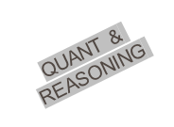
WELCOME
TO
QUANTITATIVE APTITUDE
&
REASONING DIVISION
university

Slide 2
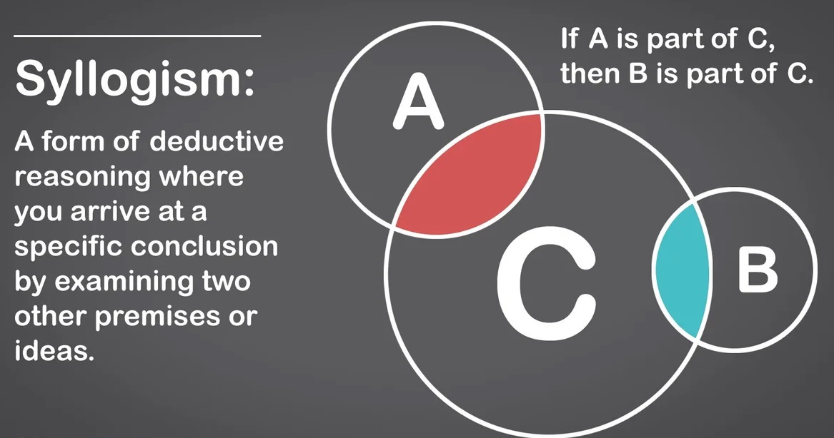
This Photo by Unknown Author is licensed under CC BY
QUANTITATIVE APTITUDE & REASONING DIVISION

Slide 3
SYLLOGISM
Question 1:
Statements:
(1)All birds are Trees
(2)Some Trees are Hens
Conclusions:
(1)Some birds are Hens
(2)Some Hens are Trees
A)If only conclusion I follows.
B)If only conclusion II follows.
C)If either conclusion I or conclusion II follows.
D)If neither conclusion I nor conclusion II follows.
E)If both conclusion I and conclusion II follows.
QUANTITATIVE APTITUDE & REASONING DIVISION

Slide 4
SYLLOGISM
Question:2
Statements:
(1)All Roads are poles
(2)No pole is a House
Conclusions:
(1)Some Roads are Houses
(2)Some Houses are Poles
A)If only conclusion I follows.
B)If only conclusion II follows.
C)If either conclusion I or conclusion II follows.
D)If neither conclusion I nor conclusion II follows.
E)If both conclusion I and conclusion II follows.
QUANTITATIVE APTITUDE & REASONING DIVISION

Slide 5
SYLLOGISM
Question :3
Statements:
(1)Some rooms are stones
(2)All stones are radios
Conclusions:
(1)Some rooms are radios
(2)Some stones are rooms
A)If only conclusion I follows.
B)If only conclusion II follows.
C)If either conclusion I or conclusion II follows.
D)If neither conclusion I nor conclusion II follows.
E)If both conclusion I and conclusion II follows.
QUANTITATIVE APTITUDE & REASONING DIVISION

Slide 6
SYLLOGISM
Question:4
Statements:
(1)All tables are Chalks
(2)All chalks are Chairs
Conclusions:
(1)All Chairs are tables
(2)All tables are Chairs
A)If only conclusion I follows.
B)If only conclusion II follows.
C)If either conclusion I or conclusion II follows.
D)If neither conclusion I nor conclusion II follows.
E)If both conclusion I and conclusion II follows.
QUANTITATIVE APTITUDE & REASONING DIVISION

Slide 7
SYLLOGISM
Question:5
Statements:
(1)Some dogs are bats
(2)Some bats are cats
Conclusions:
(1)Some dogs are cats
(2)Some cats are dogs
A)If only conclusion I follows.
B)If only conclusion II follows.
C)If either conclusion I or conclusion II follows.
D)If neither conclusion I nor conclusion II follows.
E)If both conclusion I and conclusion II follows.
QUANTITATIVE APTITUDE & REASONING DIVISION

Slide 8
SYLLOGISM
Question 6:
Statements:
(1)Some birds are flowers
(2)Some flowers are Chocolates
Conclusions:
(1)Some birds are Chocolates
(2)No chocolate is a flower
A)If only conclusion I follows.
B)If only conclusion II follows.
C)If either conclusion I or conclusion II follows.
D)If neither conclusion I nor conclusion II follows.
E)If both conclusion I and conclusion II follows.
QUANTITATIVE APTITUDE & REASONING DIVISION

Slide 9
SYLLOGISM
Question 7:
Statements:
(1)Some pens are tables
(2)No table is blue
Conclusions:
(1)Some tables are pens
(2)No pen is blue
A)If only conclusion I follows.
B)If only conclusion II follows.
C)If either conclusion I or conclusion II follows.
D)If neither conclusion I nor conclusion II follows.
E)If both conclusion I and conclusion II follows.
QUANTITATIVE APTITUDE & REASONING DIVISION

Slide 10
SYLLOGISM
Question 8:
Statements:
(1)All books are pencils
(2)All pencils are flowers
Conclusions:
(1)All books are flowers
(2)Some pencils are not books
A)If only conclusion I follows.
B)If only conclusion II follows.
C)If either conclusion I or conclusion II follows.
D)If neither conclusion I nor conclusion II follows.
E)If both conclusion I and conclusion II follows.
QUANTITATIVE APTITUDE & REASONING DIVISION

Slide 11
SYLLOGISM
Question 9:
Statements :
(1)Some crows are Jackals
(2)No fox is a crow
Conclusions:
(1)Some jackals are foxes
(2)some jackals are not foxes
A)If only conclusion I follows.
B)If only conclusion II follows.
C)If either conclusion I or conclusion II follows.
D)If neither conclusion I nor conclusion II follows.
E)If both conclusion I and conclusion II follows.
QUANTITATIVE APTITUDE & REASONING DIVISION

Slide 12
SYLLOGISM
Question 10:
Statements:
(1)Some cats are animals
(2)No historian is an animal
Conclusions:
(1)Some cats are not historians
(2)Some historians are Cats
A)If only conclusion I follows.
B)If only conclusion II follows.
C)If either conclusion I or conclusion II follows.
D)If neither conclusion I nor conclusion II follows.
E)If both conclusion I and conclusion II follows.
QUANTITATIVE APTITUDE & REASONING DIVISION

Slide 13
SYLLOGISM
Question 11:
Statements:
(1)Few rats are cats
(2)All tigers are Elephants
(3)At least some monkeys are cats
(4)No monkeys are Tigers
Conclusions:
(1)All rats are Elephants
(2)Some Elephants are Tigers
(3)Some monkeys are rats
(4)Some cats are monkeys
Mark answer as:
(a)If only II follows
(b)If only I follows
(c)If only II and IV follows
(d) If only III follows
(e) None of these
QUANTITATIVE APTITUDE & REASONING DIVISION

Slide 14
SYLLOGISM
Question 12: Statements:
(1)Many carrots are potatoes
(2)All potatoes are Tomatoes
(3)No Tomatoes are cucumbers
(4)At least some cucumbers are Beans
Conclusions:
(1)Some Tomatoes are Carrots
(2)Some Cucumbers are Potatoes
(3)All carrots are Tomatoes
(4)Some Beans are carrots
Mark answer as:
(a)If only I follows
(b)If only III follows
(c)If only I & II follows
(d)If only I & IV follows
(e) None
QUANTITATIVE APTITUDE & REASONING DIVISION

Slide 15
SYLLOGISM
Question 13: Statements:
(1)At least some Bikes are cars
(2)All Bikes are Vans
(3)All Vans are Buses
(4)No trains are Vans
Conclusions:
(1)Some Buses are Cars
(2)No Bikes are Trains
(3)No trains are cars
(4)Some trains are not Buses.
Mark answer as :
(a)If only I follows
(b)If only I & II follows
(c)If only I , II, III follows
(d)If all follows
(e) If None follows
QUANTITATIVE APTITUDE & REASONING DIVISION

Slide 16
SYLLOGISM
Q(14)Statements:
(1)All apples are Bananas
(2)Some Apricots are Mangoes
(3)No bananas are Apricots
(4)All Mangoes are Blackberries
Conclusions:
(1)No Apricots are Apples
(2)No apples are Mangoes
(3)Some apples being Blackberries is a possibility
(4)All Bananas being Mangoes is a possibility
Mark answer as:
(a)If only I follows
(b)If only I & III follows
(c)If only I, III, IV follows
(d)If all follows
(e)None
QUANTITATIVE APTITUDE & REASONING DIVISION

Slide 17
SYLLOGISM
Question 15: Statements:
(1)All Locks are Doors
(2)All Doors are Chairs
(3)No Tables are Doors
(4)All Tables are Windows
Conclusions:
(1)Some locks are not tables
(2)All locks being windows is a possibility
(3)All chairs being windows is a possibility
(4)All windows being chairs is a possibility
Mark answer as:
(a)If only I follows
(b)If only II and III follows
(c)If only I, II, III follows
(d)If all follows
(e)None of these
QUANTITATIVE APTITUDE & REASONING DIVISION

Slide 18
SYLLOGISM
Question 16: Statements:
(1)All Doctors are Scientists
(2)All lawyers are Engineers
(3)No engineers are Doctors
(4)Some teachers are Engineers
Conclusions:
(1)Some Teachers are not Scientists
(2)No Doctors are lawyers
Mark answer as:
(a)If only I follows
(b)If only II follows
(c)If either I or II follows
(d)If neither I nor II follows
(e) If both I & II follows
QUANTITATIVE APTITUDE & REASONING DIVISION

Slide 19
SYLLOGISM
Question 17: Statements:
(1)All Doctors are Scientists
(2)All lawyers are Engineers
(3)No engineers are Doctors
(4)Some teachers are Engineers
Conclusions:
(1)Some Scientists are Engineers
(2)No scientists are Engineers
Mark answer as :
(a)If only I follows
(b)If only II follows
(c)If either I or II follows
(d)If neither I nor II follows
(e) If Both I & II
QUANTITATIVE APTITUDE & REASONING DIVISION

Slide 20
SYLLOGISM
Question 18: Statements:
(1)All Doctors are Scientists
(2)All lawyers are Engineers
(3)No engineers are Doctors
(4)Some teachers are Engineers
Conclusions:
(1)All teachers are Engineers
(2)Some teachers are not Engineers
Mark answer as:
(a)If only I follows
(b)If only II follows
(c)If either I or II follows
(d)If neither I nor II follows
(e)If both I and II follows
QUANTITATIVE APTITUDE & REASONING DIVISION

Slide 21
SYLLOGISM
Question 19: Statements:
(1)Some Houses are Schools
(2)All schools are not bags
(3)No bags are pencils
(4)All pencils are Pens
Conclusions:
(1)All schools being pencils is a possibility
(2)Some pencils are Houses
(3)All pens being Bags is a possibility
(4)No pencils are Houses
Mark answer as;
(a)If only I follows
(b)If either II or IV follows
(c)If only I & either II or IV follows
(d)If only III follows
(e)If only III and either II or IV follows
QUANTITATIVE APTITUDE & REASONING DIVISION

Slide 22
SYLLOGISM
Question 20: Statements:
Some tables are chairs.
No cupboard is table.
Some chairs are cupboards.
Conclusions:
I. Some chairs are not tables
II. All chairs are either tables or cupboard
III. Some chairs are both tables and cupboards.
IV. All chairs are tables.
a. Only I and IV follow
b. Only either II or III follow
c. Only IV follows
d. None of these
QUANTITATIVE APTITUDE & REASONING DIVISION

Slide 23
SYLLOGISM
Question 21: Statements:
Some pencils are pens.
All pens are erasers.
All staplers are erasers.
Conclusions:
I. Some pens are not pencils.
II. All erasers are pencils.
III. Some staplers are pens.
IV. Some staplers are pencils.
a. Only I follow
b. Only II follows
c. Only III follows
d. None of these
QUANTITATIVE APTITUDE & REASONING DIVISION

Slide 24
SYLLOGISM
Question 22: Statements:
Some cups are utensils.
No utensil is a bucket.
All buckets are plates.
Conclusions:
I. Some cups are buckets.
II. Some utensils are plates.
III. No utensil is a plate.
IV. Some cups are plates.
a. Only I follow
b. Only III follows
c. Either II or III follows
d. Either III or IV follows
QUANTITATIVE APTITUDE & REASONING DIVISION

Slide 25
SYLLOGISM
Question 23: Statements:
Some oranges are apples.
All apples are guavas.
No guava is a banana.
Conclusions:
I. Some guavas are oranges.
II. No apple is a banana.
III. Some oranges are bananas.
IV. Some apples are bananas.
a. Only I and II follow
b. Only I and either II or IV follow
c. Only I, II and IV follow
d. Only III and either II or IV follow
QUANTITATIVE APTITUDE & REASONING DIVISION

Slide 26
SYLLOGISM
Question 24: Statements:
Some trains are cars.
All cars are branches.
All branches are nets.
Some nets are dresses.
Conclusions:
I. Some dresses are definitely cars.
II. All nets are trains.
III. At least some branches are trains.
IV. All dresses being trains is a possibility.
a. I and II follow
b. II and III follow
c. I and IV follow
d. III and IV follow
e. None of these
QUANTITATIVE APTITUDE & REASONING DIVISION

Slide 27
SYLLOGISM
Question 25: Statements:
Some spectacles are boxes.
No bat is a ball.
Some boxes are balls.
Conclusions:
I. Some boxes are not bats.
II. Some bats are spectacles.
III. No bat is a box.
IV. No ball is a spectacle.
a. Only I follow
b. Only 1 & III follow
c. Only II and III follow
d. Only IV follows
QUANTITATIVE APTITUDE & REASONING DIVISION

Slide 28
SYLLOGISM
Question 26: Statements:
Some stones are rocks.
All rocks are boulder.
Some boulders are mountains.
All hills are mountains.
Conclusions:
I. Some stones are not mountains.
II. At least some hills are boulders.
III. Some boulders are stones.
IV. All mountains being hills is a possibility.
a. None follows
b. Only II follows
c. II and III follow
d. III and IV follow
e. None of these
QUANTITATIVE APTITUDE & REASONING DIVISION

Slide 29
SYLLOGISM
Question 27: Statements:
All arrows are bows.
All bows are swords.
Some swords are daggers.
All daggers are knives.
Conclusions:
I. All knives are bows.
II. At least some swords are knives.
III. All bows are not arrows.
IV. All arrows being swords is a possibility.
a. Only II follows
b. II and IV follow
c. III and IV follow
d. I and III follow
e. None of these
QUANTITATIVE APTITUDE & REASONING DIVISION

Slide 30
SYLLOGISM
Question 28: Statements:
Some pianos are violins.
Some violins are drums.
All drums are guitars.
No guitar is a flute.
Conclusions:
I. All guitars are pianos.
II. Some drums are definitely flutes.
III. At least some pianos are drums.
IV. No flute is a drum.
a. None follows
b. Only I follow
c. Either II or IV follows
d. Only IV follows
e. None of these
QUANTITATIVE APTITUDE & REASONING DIVISION

Slide 31
SYLLOGISM
Question 29: Statements:
Some airplanes are helicopters.
All helicopters are gliders.
All gliders are kites.
All kites are balloons.
Conclusions:
I. At least some helicopters are balloons.
II. All kites are airplanes.
III. All balloons are not gliders.
IV. All helicopters being kites is a possibility.
a. Only IV follows
b. Either II or III follows
c. Only III follows
d. Only I follow
e. None of these
QUANTITATIVE APTITUDE & REASONING DIVISION

Slide 32
SYLLOGISM
Question 30: Statements:
All kings are warriors.
All soldiers is warriors.
All sentries are warriors.
Some sentries are soldiers.
Conclusions:
I. Some sentries are kings.
II. Only warrior is soldiers.
III. All warriors are not sentries.
IV. Some soldiers being kings is a possibility.
a. None follows
b. Only I follow
c. Only II follows
d. II and IV follow
e. None of these
QUANTITATIVE APTITUDE & REASONING DIVISION

Slide 33
SYLLOGISM
KEY
1. | B | 11. | C | 21.
2. | D | 12. | A | 22.
3. | E | 13. | B | 23.
4. | B | 14. | C | 24.
5. | D | 15. | D | 25.
6. | D | 16. | D | 26.
7. | A | 17. | C | 27.
8. | A | 18. | C | 28.
9. | B | 19. | A | 29.
10. | A | 20. | D | 30.
QUANTITATIVE APTITUDE & REASONING DIVISION

Slide 34

QUANTITATIVE APTITUDE & REASONING DIVISION

